Slide 1
Advanced Debugging Tips and Tricks

Slide 2
Advanced Debugging Tips and Tricks
Configure behaviours to dedicate a tab for debugging
LLDB Expressions can modify program state
Use auto-continuing breakpoints with debugger commands to inject code live
Create dependent breakpoints using “breakpoint set —one-shot true”
“po $arg1” ($arg2,etc) in assembly frames to print function arguments
Skip lines of code by dragging Instruction Pointer or “thread jump —by 1”
Pause when variables are modified by using watchpoints

Slide 3
Advanced Debugging Tips and Tricks
Evaluate Obj-C code in Swift frames with “expression -l obj -0 — <expr>”
Flush view changes to the screen using “expression CATransaction.flush()”
Add custom LLDB commands using aliases and scripts.
Alias examples
command alias poc expression -l objc -0 —
command alias commodeFlush expression -l objc — (void)[CATransaction flush]
The nudge LLDB Script

Slide 4
LLDB: Beyond “po”
Use v, p, and po to print variables
Customize data formatters
filter,
summaries and
synthetic children
Use of Python3 for scripting

Slide 5
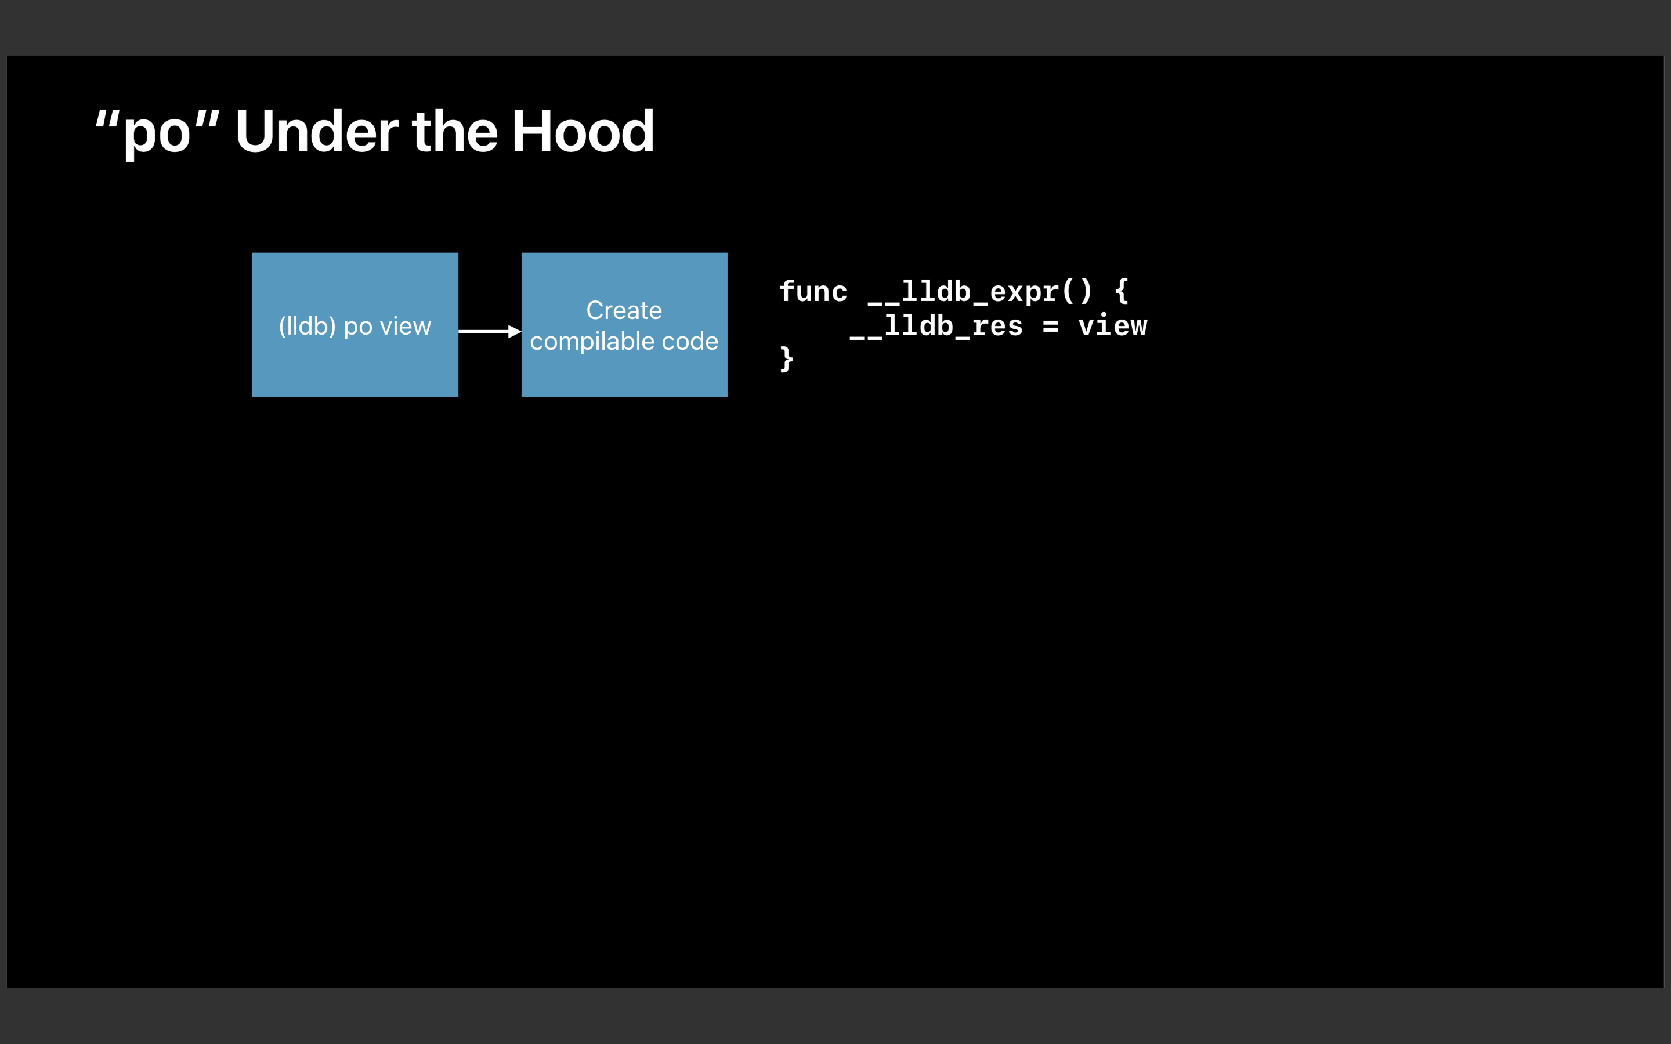

Slide 6
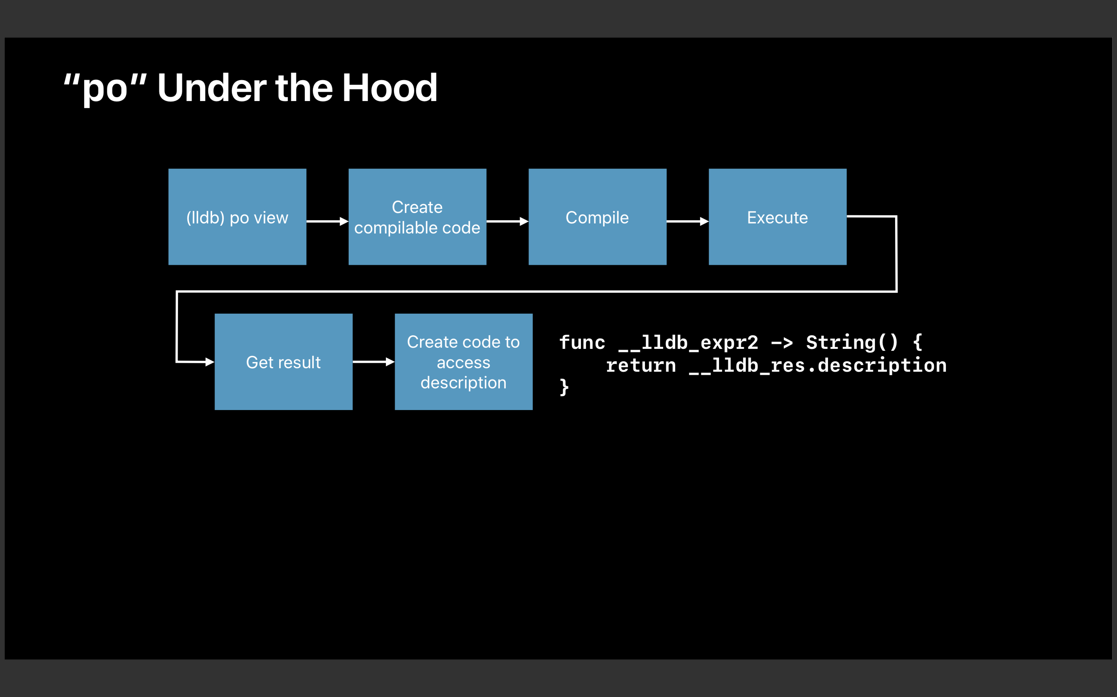

Slide 7
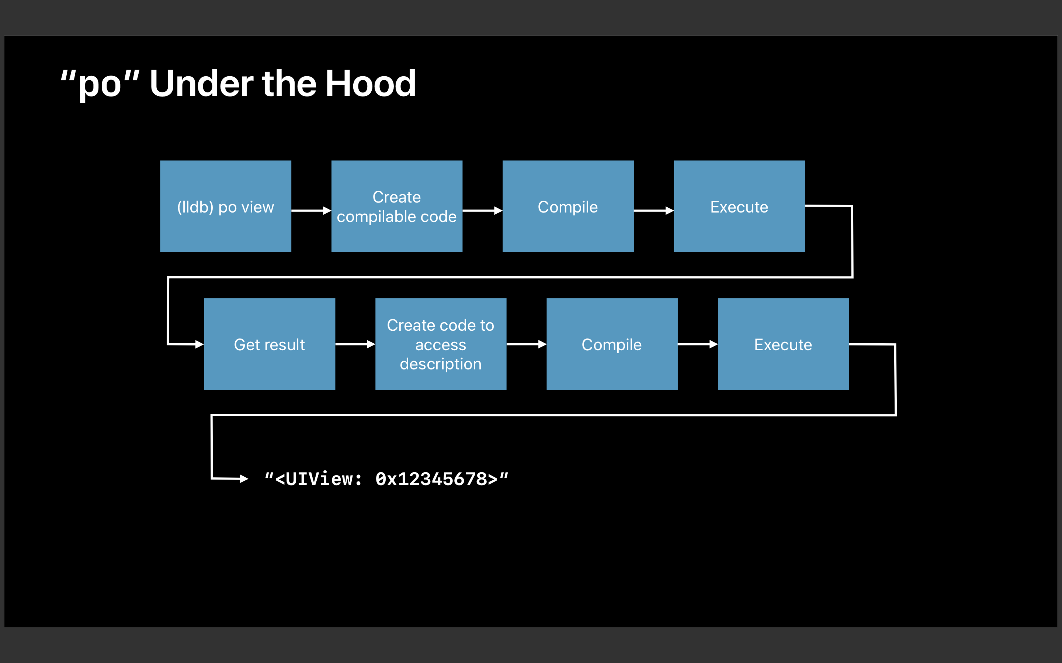

Slide 8
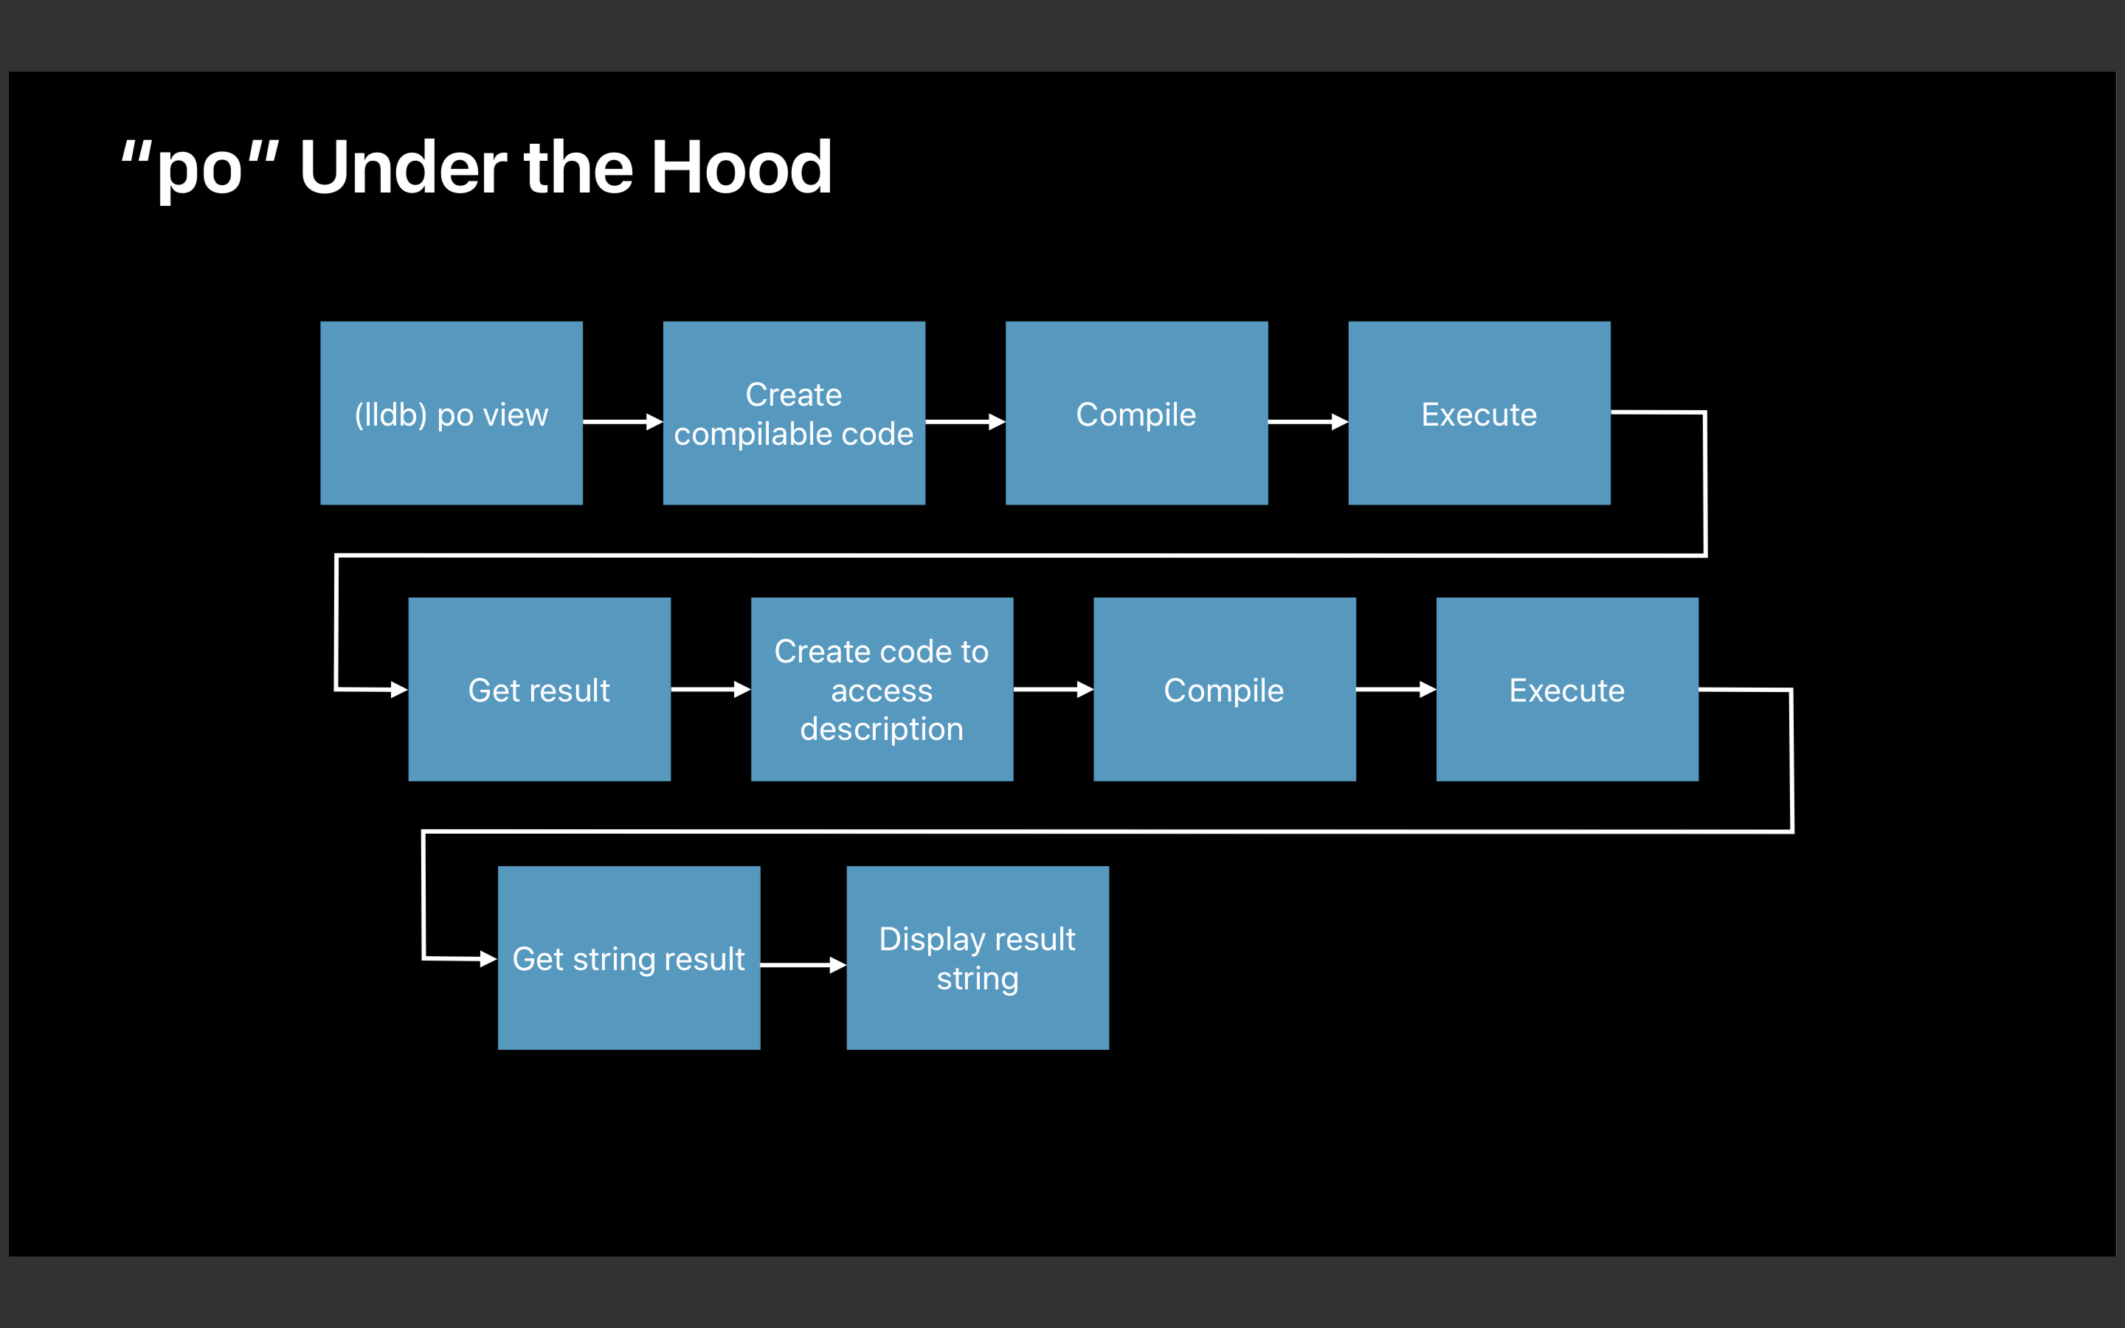

Slide 9
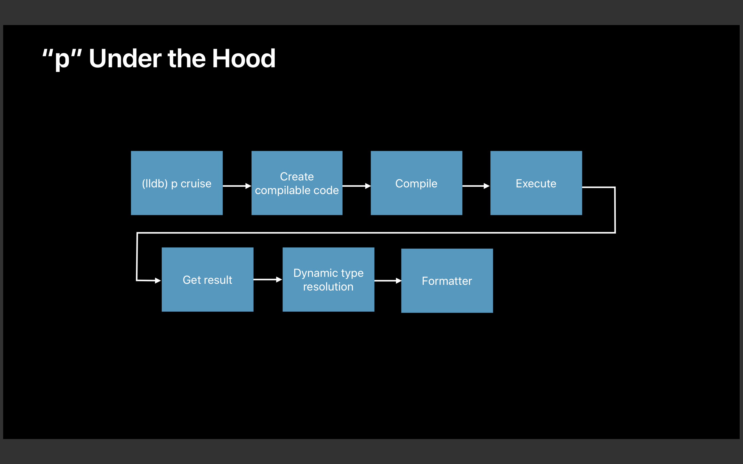

Slide 10
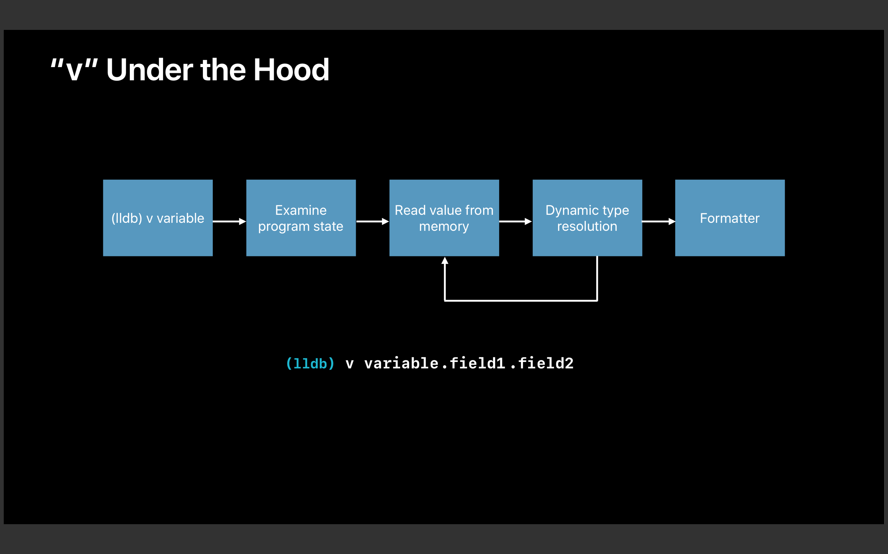

Slide 11
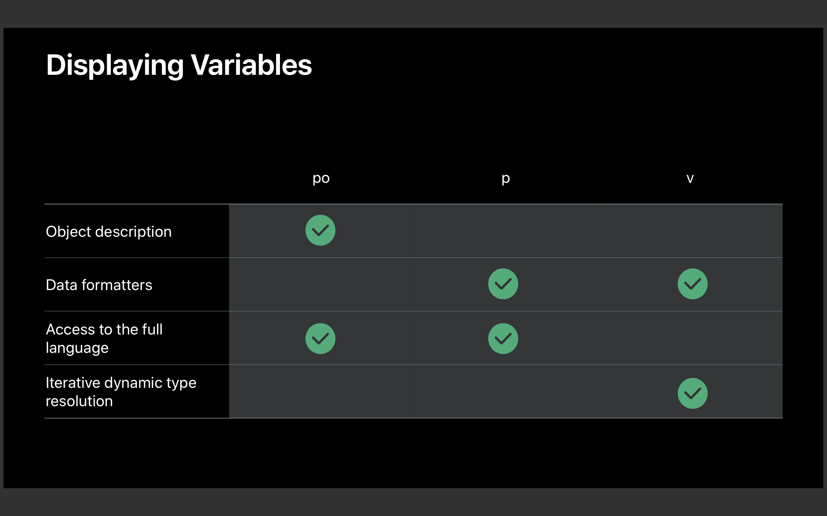

Slide 12
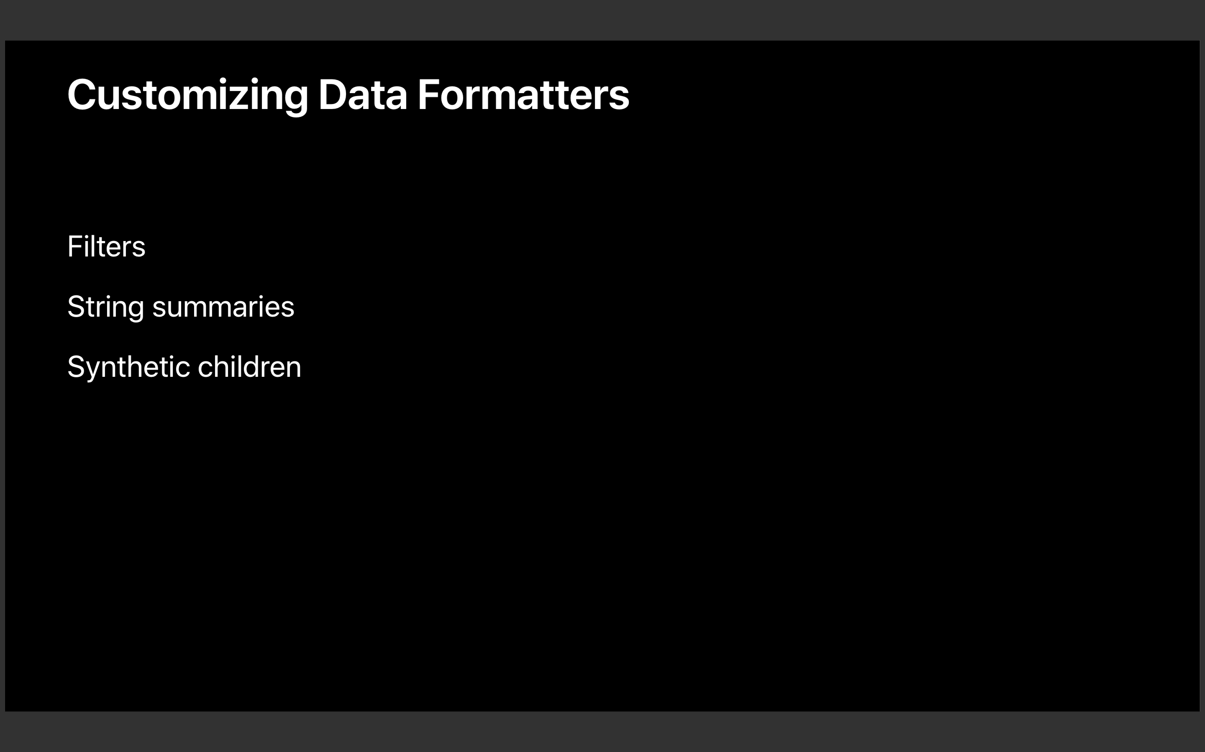

Slide 13
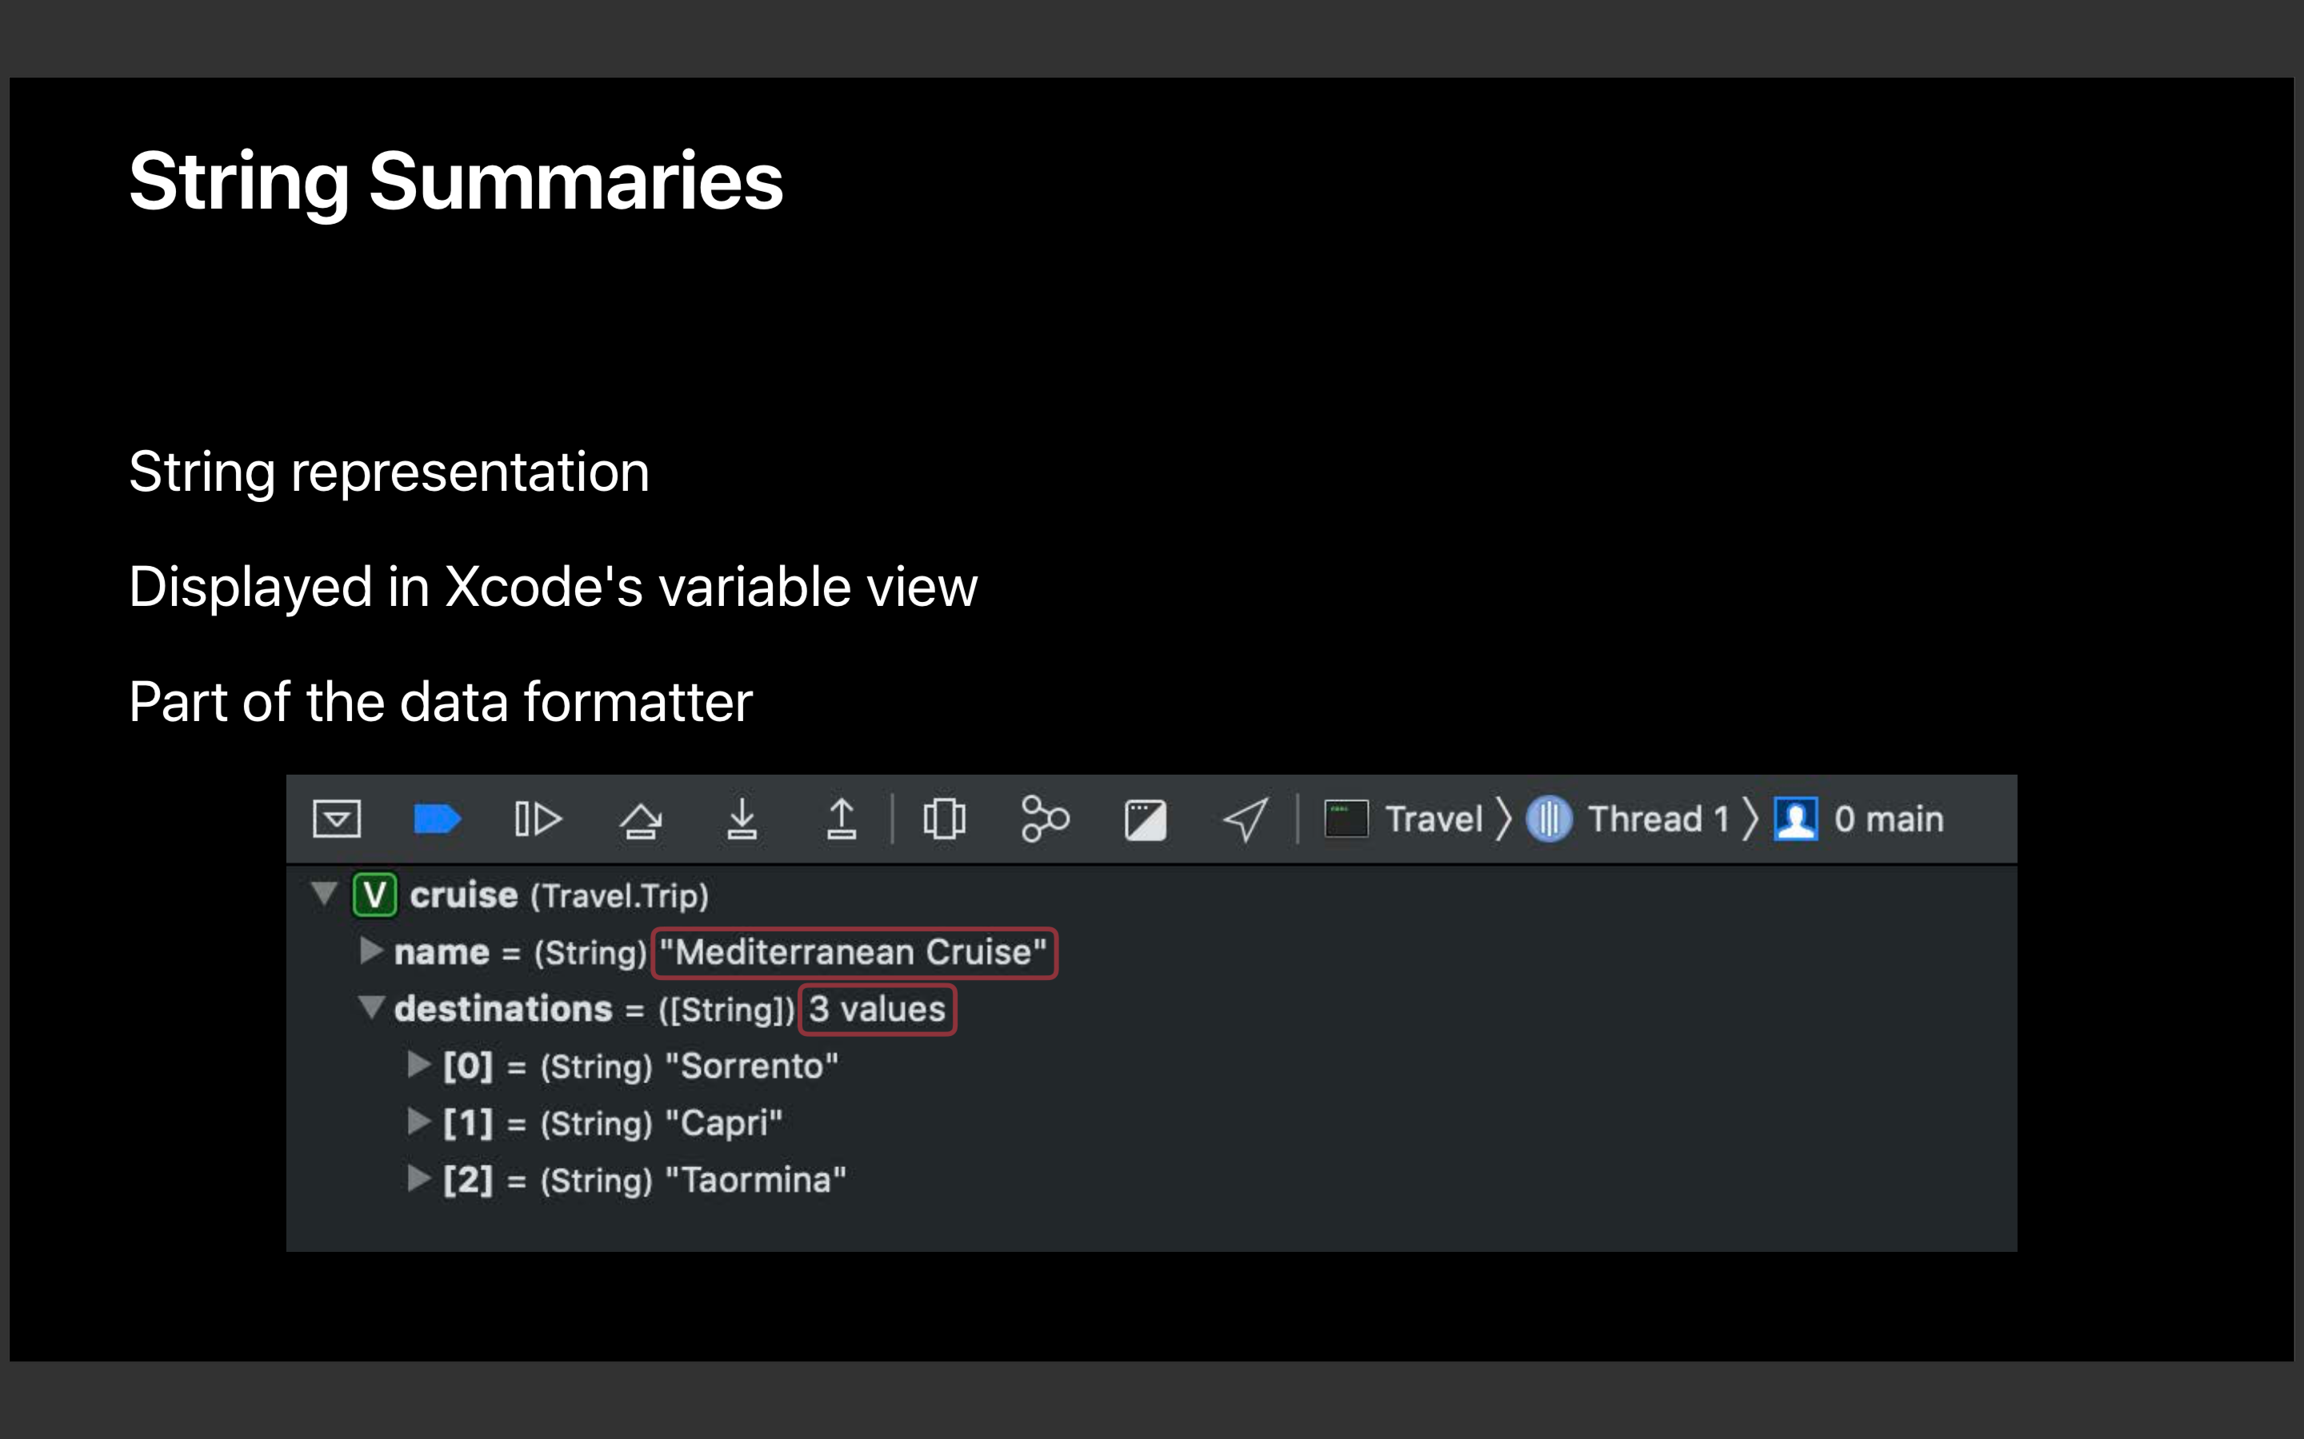

Slide 14
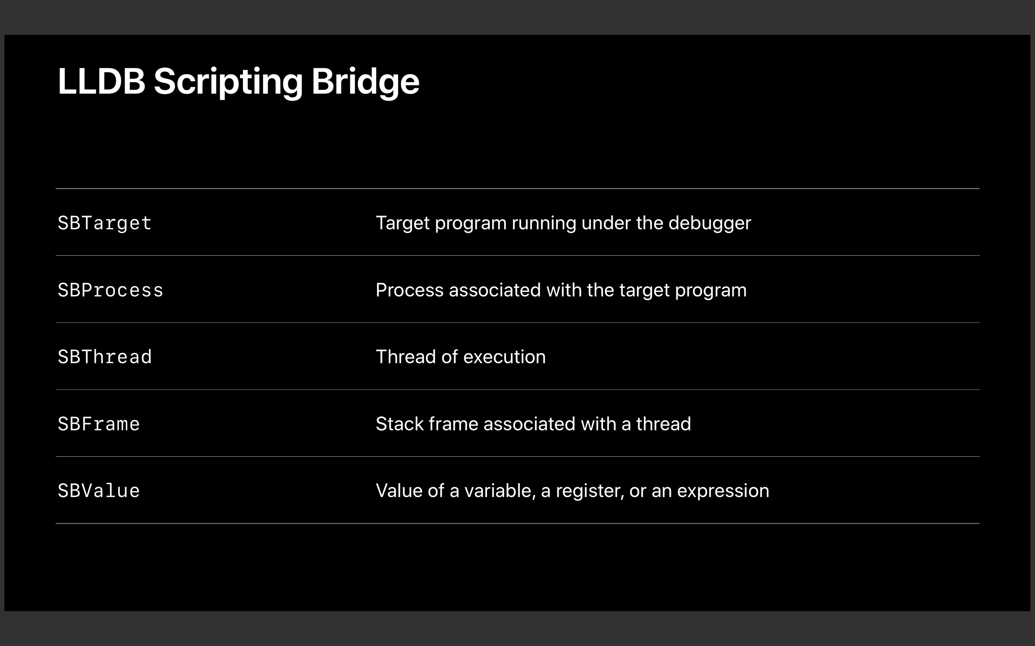

Slide 15
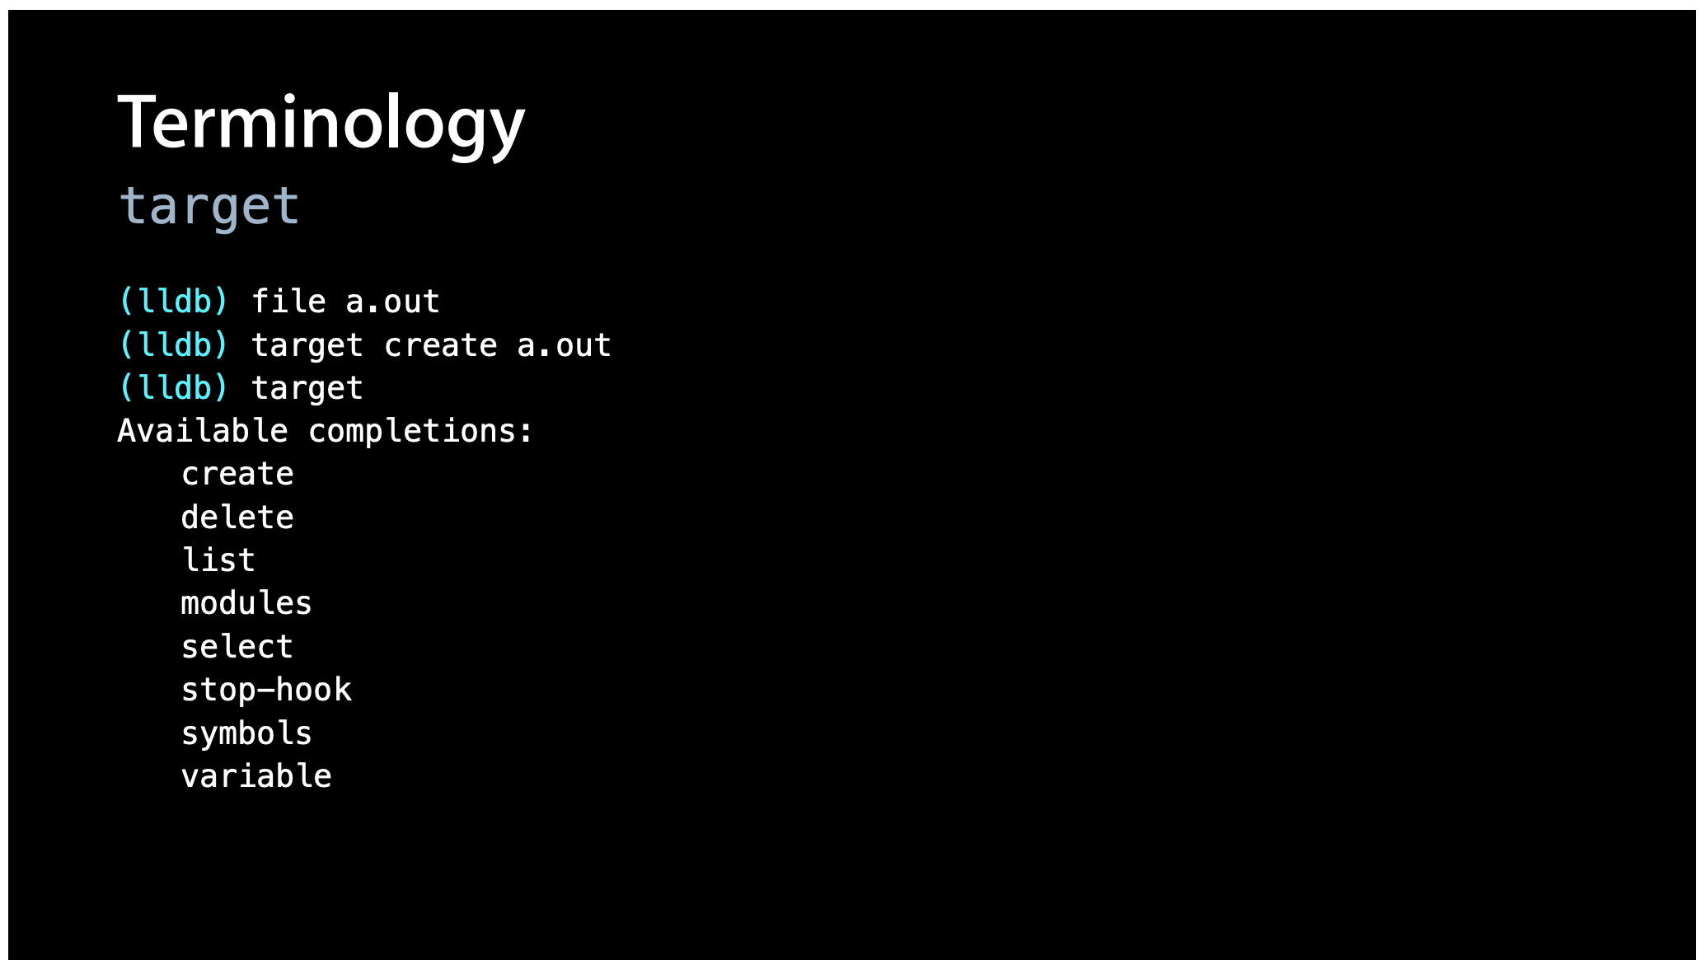

Slide 16
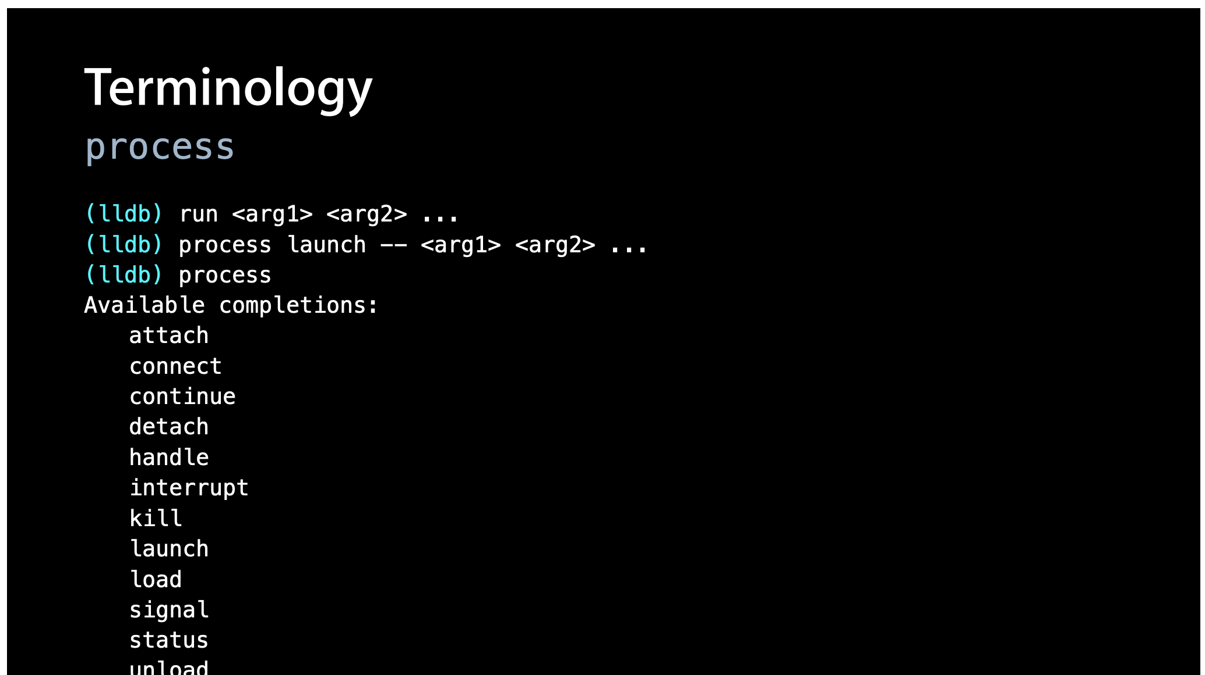

Slide 17
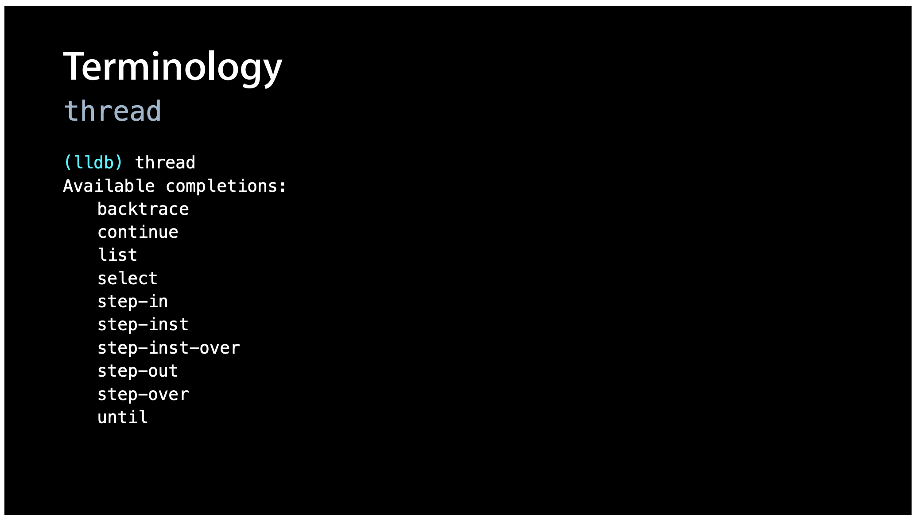

Slide 18
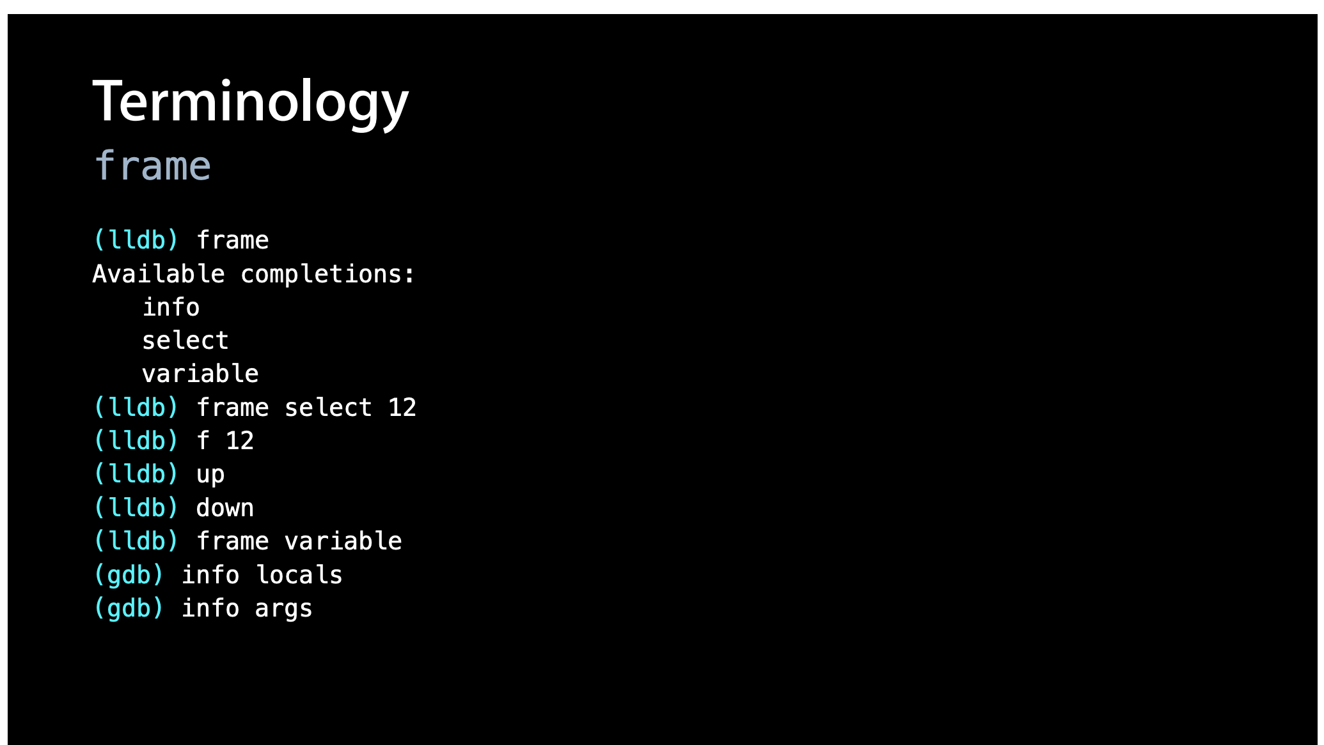

Slide 19
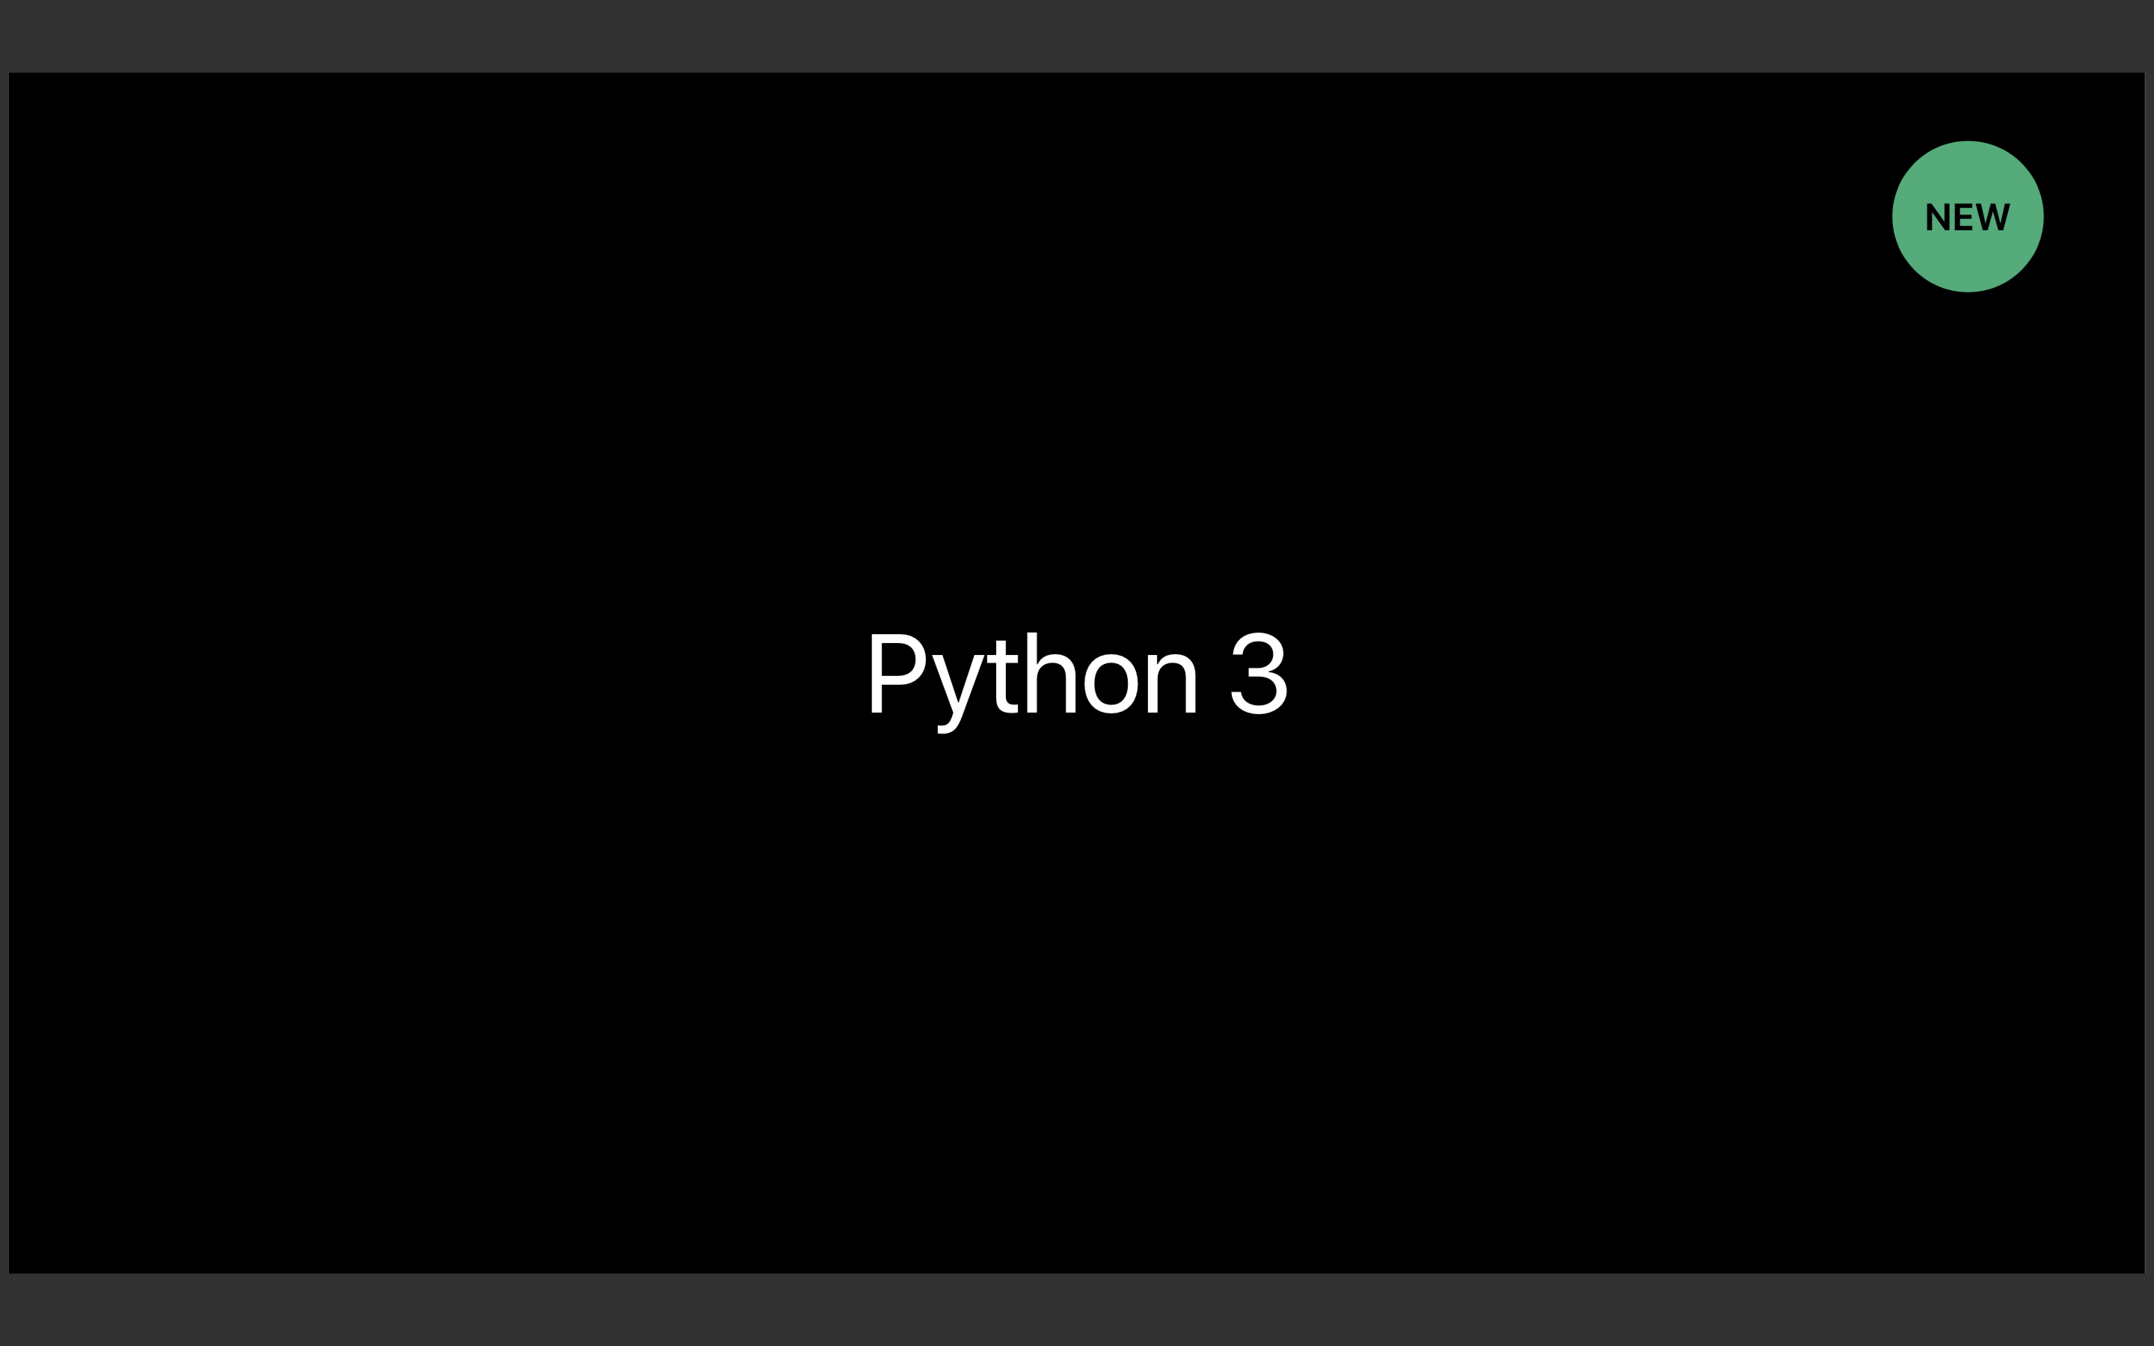

Slide 20
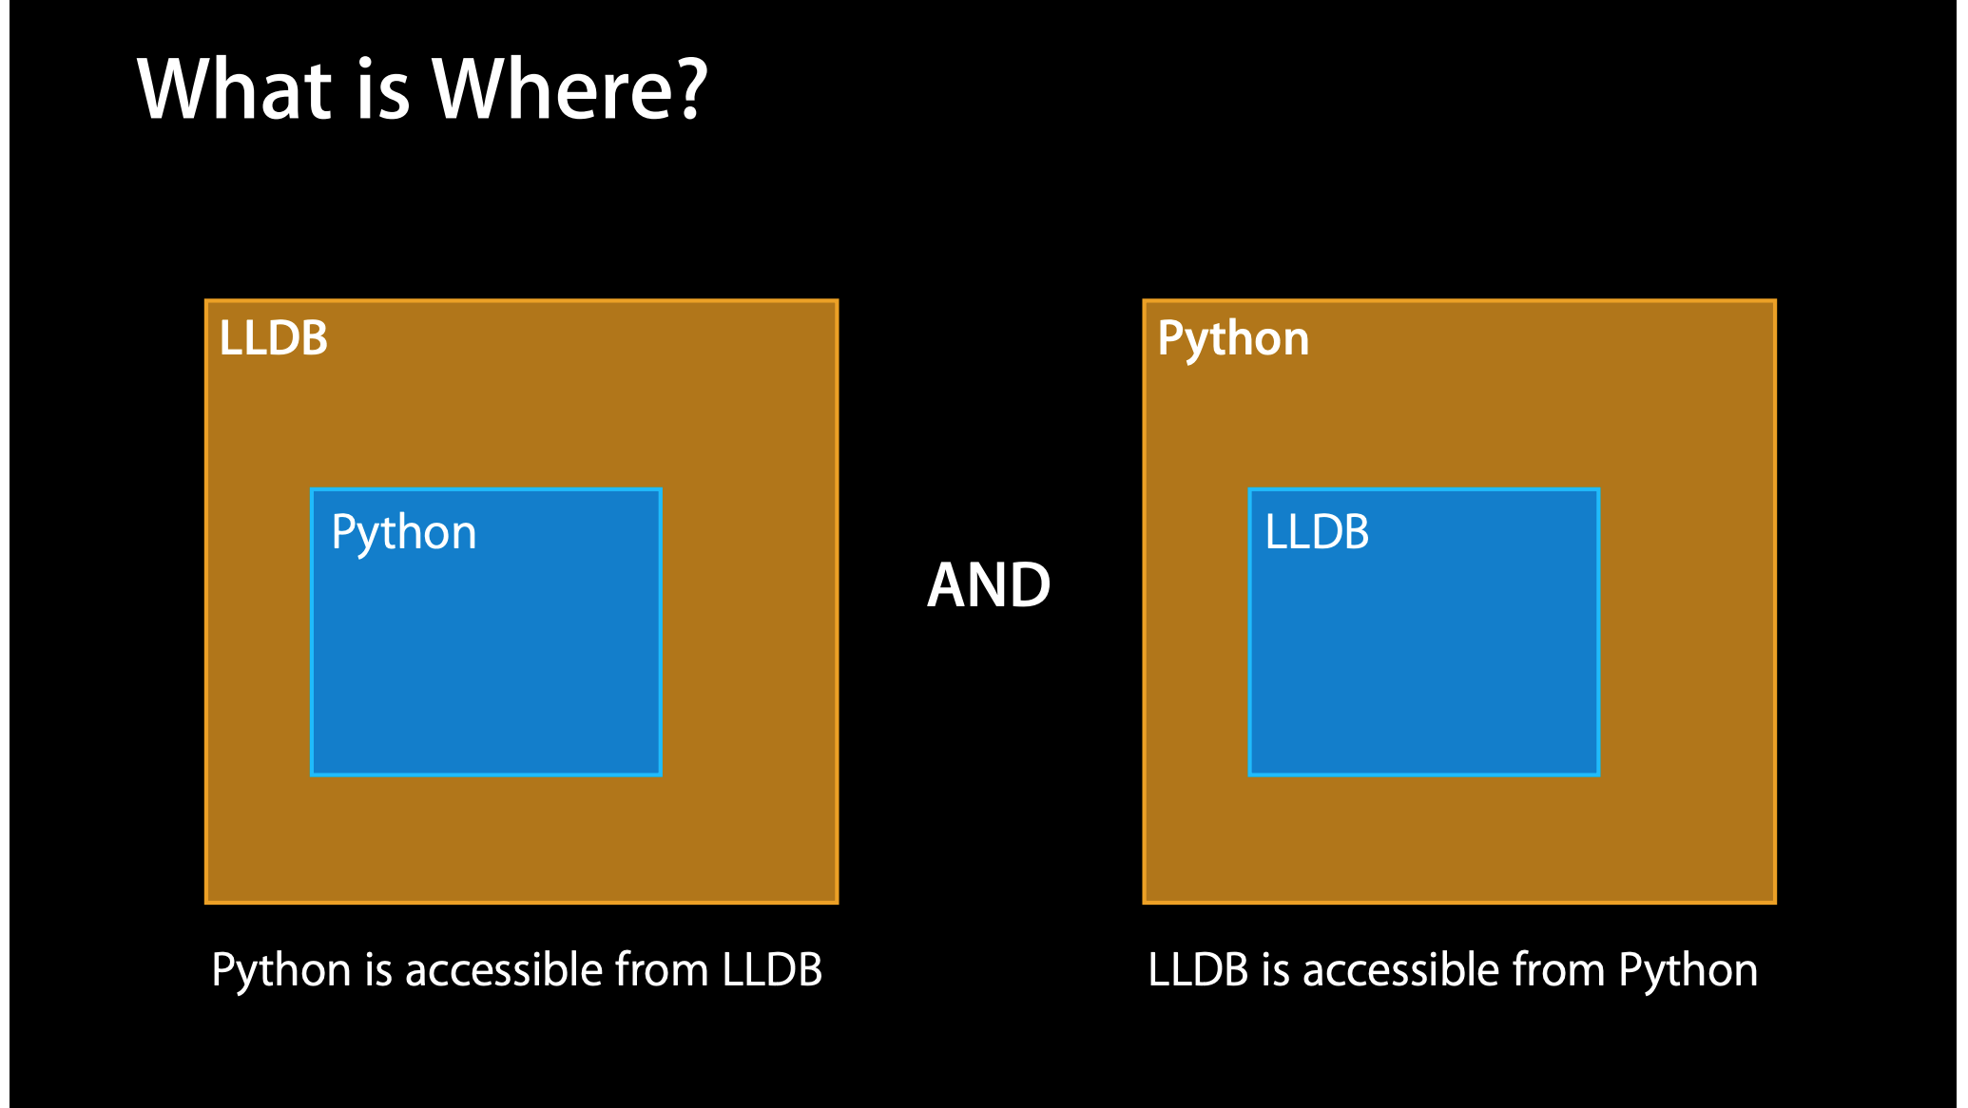

Slide 21
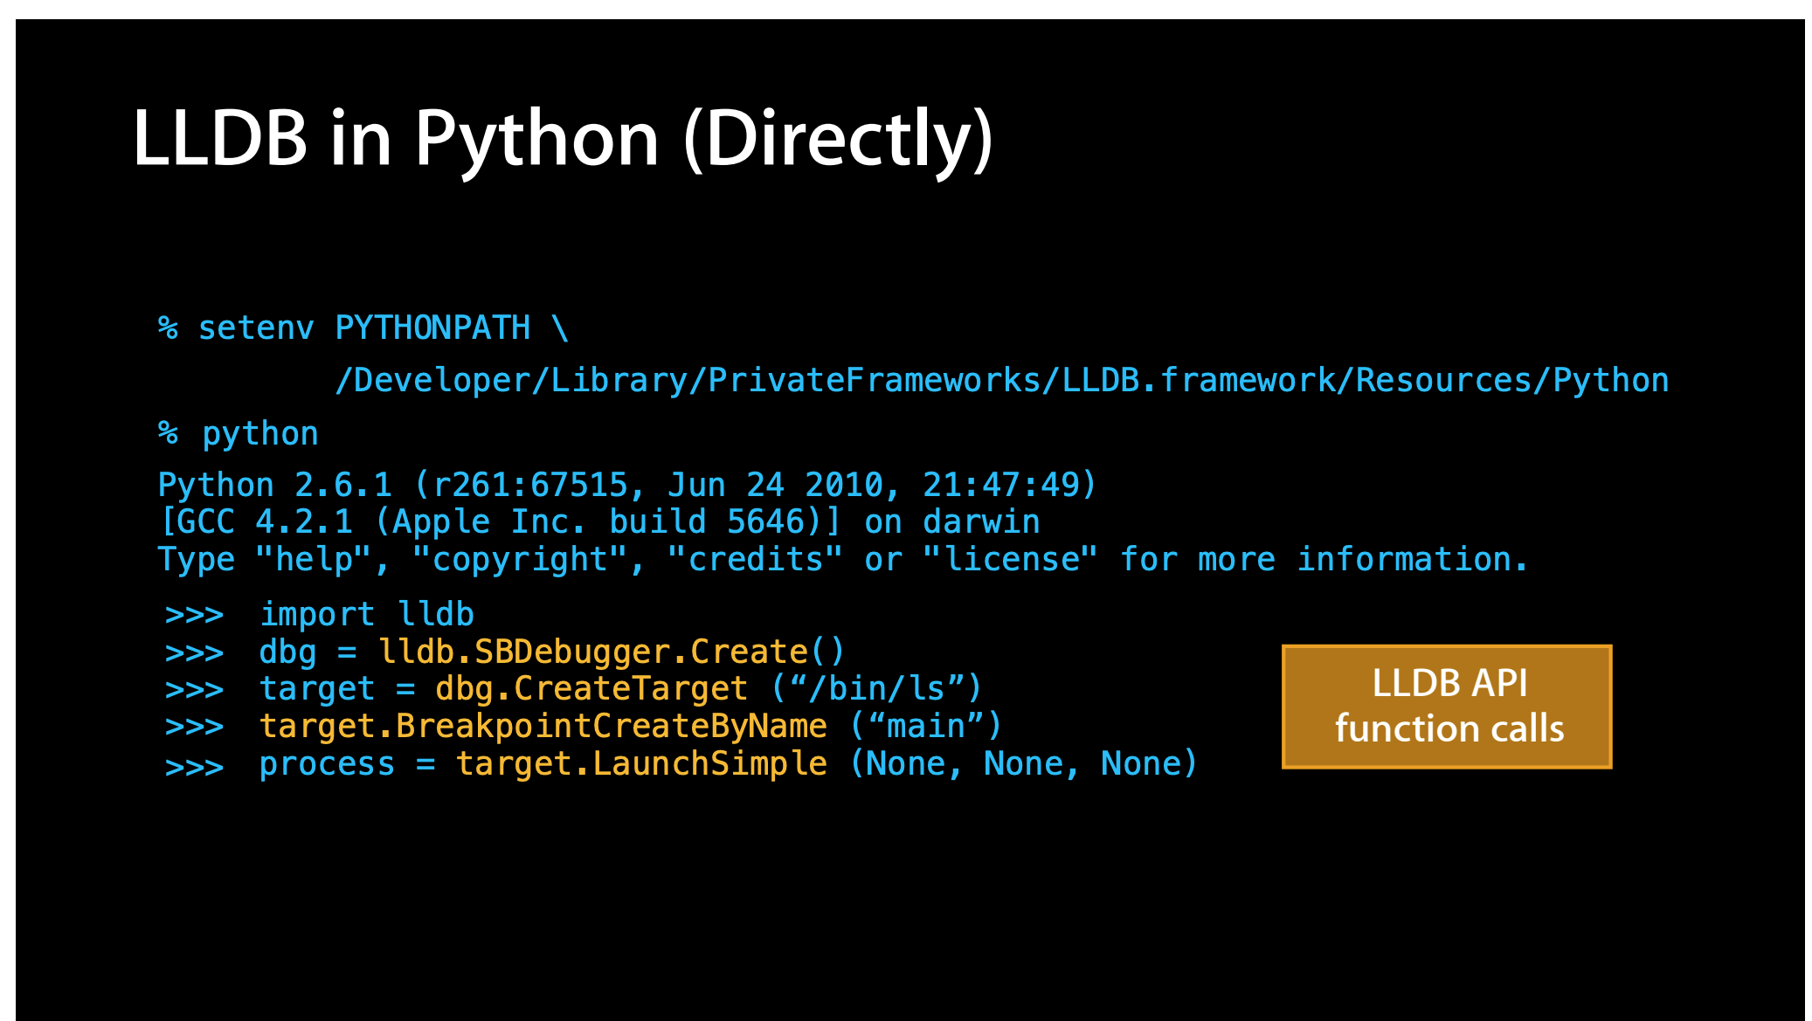

Slide 22
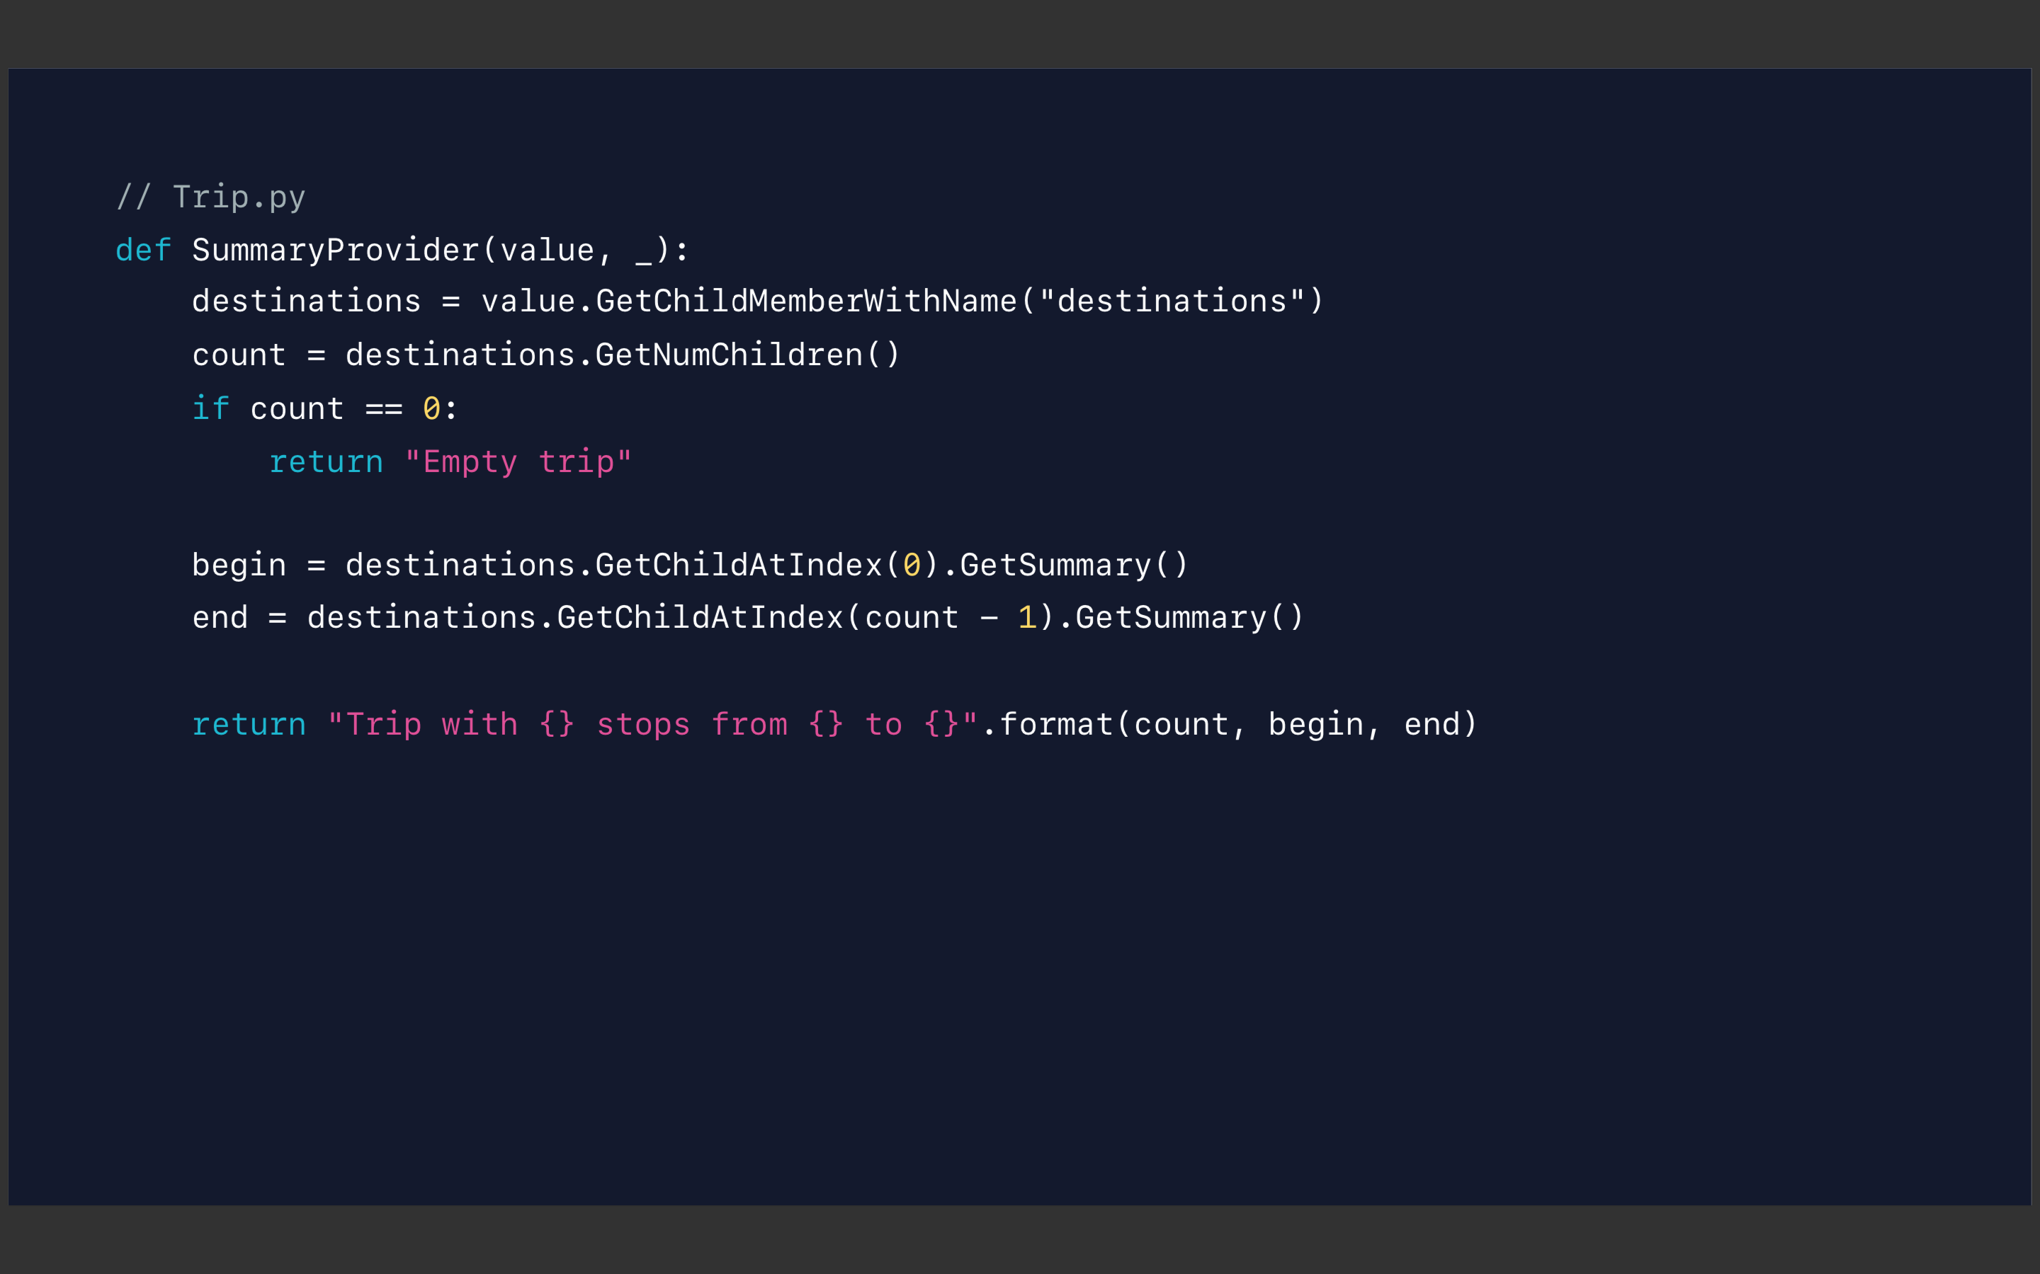

Slide 23
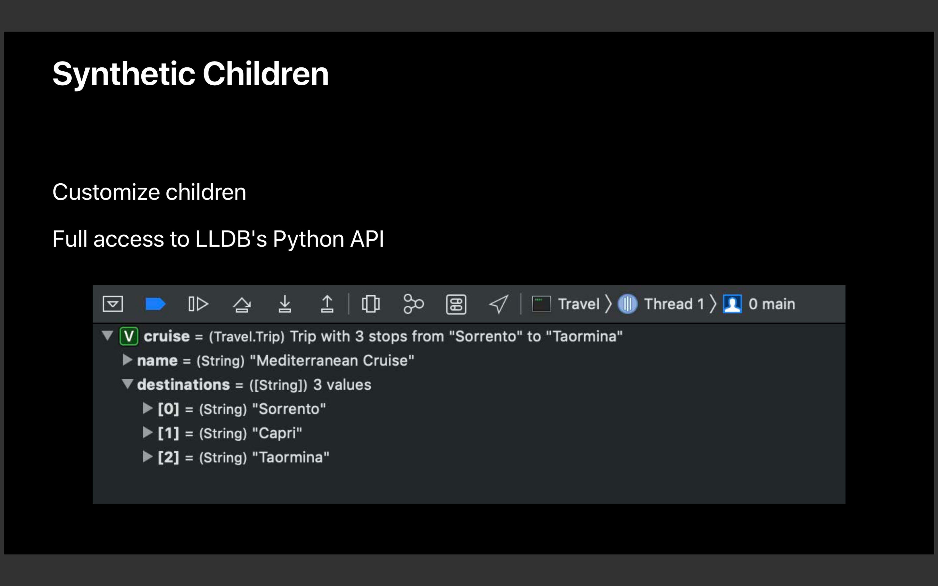

Slide 24
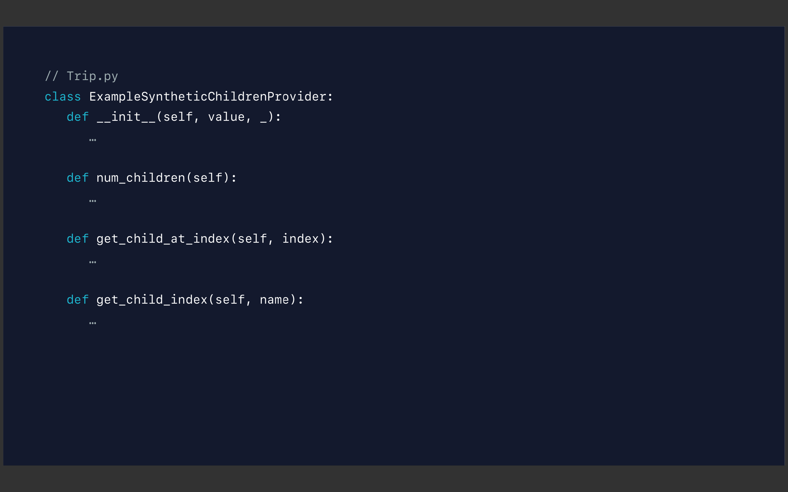

Slide 25
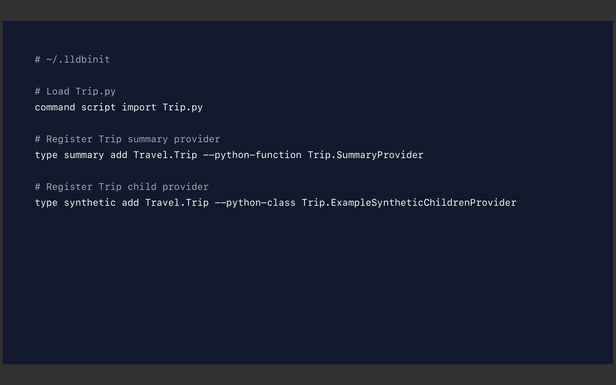

Slide 26
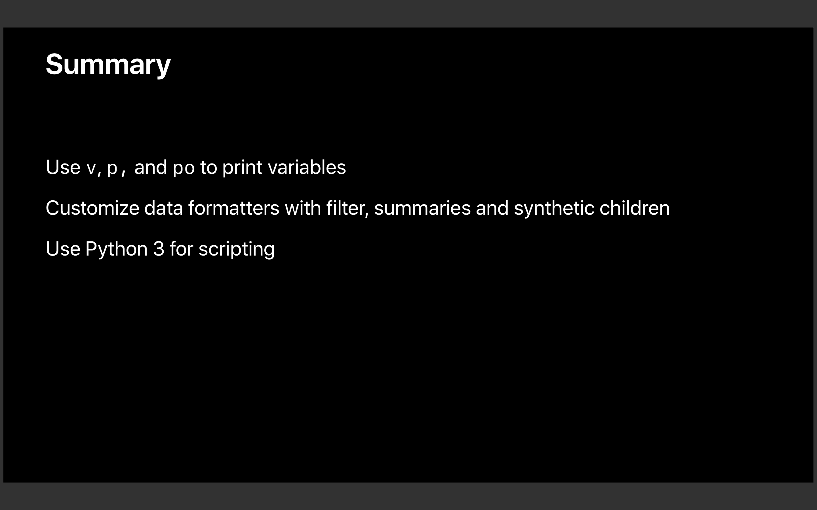

Slide 27
References:
https://developer.apple.com/videos/play/wwdc2019/429/
https://developer.apple.com/videos/play/wwdc2018/412/

